Slide 1
ALIX Geospatial

Slide 2
Introduction
Our algorithm identifies and analyzes territories within specific distances (buffers) around given points (coordinates). The data used includes geographical data (such as territories and their borders) and demographic information (such as population and employment) for each area. Demographic data is taken from the official webpage : http://dati.istat.it/
Note : A number of this demographic data can be at provincial or regional level.
The code processes this data and returns an Excel file containing the analyzed results for each coordinate-buffer distance pair.
Key concepts:
Coordinates: Latitude and longitude values representing a point on the Earth's surface.
Buffer distances: The radius around each coordinate to define the area of interest.
Territories: Geographical regions, such as municipalities or cities, represented by polygons.

Slide 3
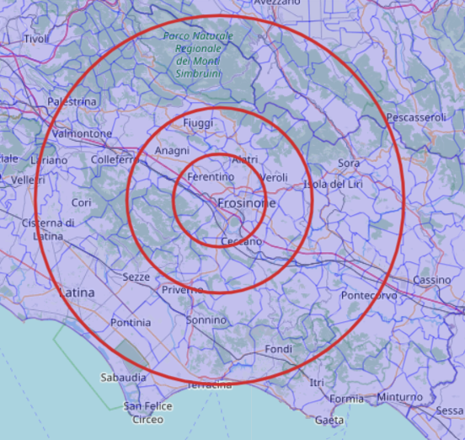
Methodology
For each given coordinate, the code creates a buffer zone with the specified radius.
It then identifies the territories that intersect with the buffer zone.
For each intersecting territory, the code calculates the percentage of its area within the buffer zone.
The code retrieves demographic data for each territory and calculates population-related statistics, such as the total and active population.
The results are then combined into a single dataset for each coordinate, including details for all buffer distances.
Finally, the code exports the data to an Excel file, with one sheet for each coordinate.
10, 20 and 40km buffer distances around Frosinone’s coordinates. Blue borders (territories) are municipalities

Slide 4
Output and applications
The output of this code is an Excel file containing demographic and geographical data for each community in the buffer zone according to the % on inclusion in the zone. The data we provide is :
Total Population
Active Population
% of Unemployment
Number of compagnies
Repartition of the population according the level of education
% of households living below the poverty line
Average Wage according to education level
A report can then be generated by taking into account the data output and the granularity of the demographic informations : municipality, provinces, regions
This information can be used for various applications, such as:
Identifying areas with specific population characteristics, such as a high concentration of working-age people.
Analyzing the impact of new infrastructure projects, like building a new factory, on nearby territories.
Supporting decision-making in urban planning, marketing, and business expansion.
This tool is versatile and can be adapted to different industries and use cases by modifying the input data and analysis parameters. We provide a GUI interface for custom demographics and custom distances

